Slide 1

Flight data exploration with spark SQL
--present by Yitong QU 45047734

Slide 2

Introduction
Big data query in flight delay and cancellation.
500MB dataset From kaggle, with enough features, and separate in three tables to store different sections ( airports, airline and flights)
Important to deploy: flight is the main way for us to travel outside with long distance,people needs to find an reliable airlines.（objective）
(flights.csv)

Slide 3

Why cloud computing?
need reduce the proportional costs like operation cost, the cloud computing reduce the investment.
For my own machine, it cannot approach high level performance in large dataset, while cloud computing increased Scalability and avoid loss.
Cloud computing increased Availability and Reliability, better in recovery with resilient IT resource.
Cloud computing can handle my ever-increasing and changing needs.

Slide 4


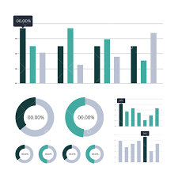
Architecture design
SQL Queries
Datasets from localhost
sparkmaster
sparkworker1
sparkworker1
sparkworker1
HDFS
load data
Namenode
datanode1
datanode1
datanode1
Visualization outputs

Slide 5
Technology
Front-end : matplotlib for the graph showing.
Backend:
HDFS to upload data,
jupyter notebook to compile the data and some implementation of the process,
Using spark to do the SQL queries, which is the main technique of this project.
import the pandas library for some data processing（eg:na.drop()）

Slide 6
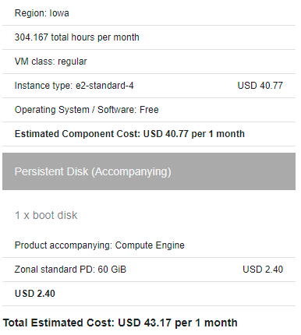

cost
Start the instance 10 hours per day an 7 days per week. So, it will cost 43.17 dollars intotal each month.

Slide 7
Spark SQL queries
and visualization ouputs

Slide 8
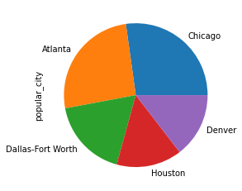


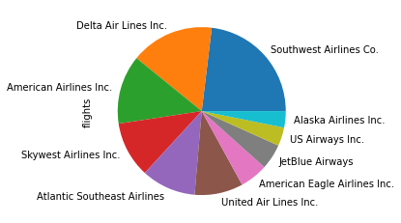

Slide 9

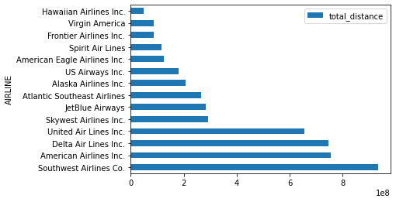
From the previous results, we know that Southwest, delta and american airline are the top three most popular airlines, which correspond to their flight distance.
Southwest airline got the longest flight distance, shows that there is enough experience to deal with emergencies.

Slide 10
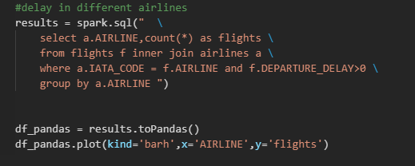

spark SQL queries

Slide 11
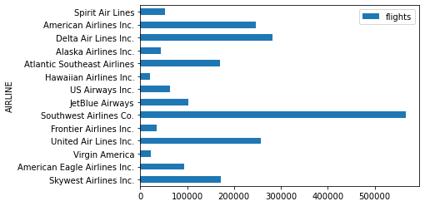
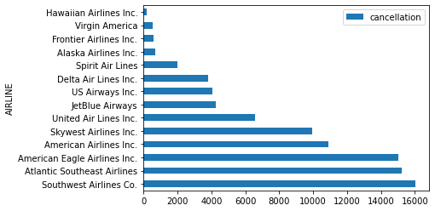
Delay and cancellation in airlines
Southwest always get delayed and cancellation,mainly because the large amountof flying.
Outlier: atlantic and american eagle airlines(not recommand).

Slide 12
conclusion
Overall, compared to delta airlines, American airline is the most worthy of travel consideration, but southwest airline has a long annual flight distance and the most flights.
However, By oberserving the flight cancellation rate,we found atlantic and american eagle airlines are the least recommended.

